Slide 1
Data Mining
Ch 10: Cluster Analysis
Cluster Analysis Basic Concepts
Type of data in clustering analysis
Wan D. Bae, Ph.D.
baewd@hanyang.ac.kr

Slide 2
Overview
Cluster Analysis Basic Concepts
Type of data in clustering analysis
Major Clustering Methods
  Partitioning Methods
  Density-Based Methods
  Hierarchical Methods
  Grid-Based Methods
Evaluation of Clustering

Slide 3
What is Cluster Analysis?
Cluster: a collection of data objects
  Similar to one another within the same cluster
  Dissimilar to the objects in other clusters
Cluster analysis
  Grouping a set of data objects into clusters
  Unsupervised classification: no predefined classes
Typical applications
  As a stand-alone tool to get insight into data distribution
  As a preprocessing step for other algorithms

Slide 4
General Applications of Clustering
Pattern recognition
Spatial data analysis
  create thematic maps in GIS by clustering feature spaces
  detect spatial clusters and explain them in spatial data mining
Image processing
Economic science (especially market research)
WWW
  Document classification
  Cluster weblog data to discover groups of similar access patterns

Slide 5
Examples of Clustering Applications
Marketing:
  Help marketers discover distinct groups in their customer bases, and then use this knowledge to develop targeted marketing programs
Land use:
  Identification of areas of similar land use in an earth observation database
Insurance:
  Identifying groups of motor insurance policy holders with a high average claim cost
City-planning:
  Identifying groups of houses according to their house type, value, and geographical location
Earth-quake studies:
  Observed earth quake epicenters should be clustered along continent faults

Slide 6
Clustering as a Preprocessing Tool (Utility)
Summarization:
  Preprocessing for regression, principal component analysis (PCA), classification, and association analysis
Compression:
  Image processing: vector quantization
Finding K-nearest Neighbors
  Localizing search to one or a small number of clusters
Outlier detection
  Outliers are often viewed as those “far away” from any cluster

Slide 7
Quality: What Is Good Clustering?
A good clustering method will produce high quality clusters
  high intra-class similarity: cohesive within clusters
  low inter-class similarity: distinctive between clusters
The quality of a clustering method depends on
  the similarity measure used by the method
  its implementation, and
  Its ability to discover some or all of the hidden patterns

Slide 8
Measure the Quality of Clustering
Dissimilarity/similarity metric
  Similarity is expressed in terms of a distance function, typically metric: d (i, j)
  The definitions of distance functions are usually rather different for interval-scaled, boolean, categorical, ordinal ratio, and vector variables
  Weights should be associated with different variables based on applications and data semantics
Quality of clustering:
  There is usually a separate “quality” function that measures the “goodness” of a cluster.
  It is hard to define “similar enough” or “good enough”
    The answer is typically highly subjective

Slide 9
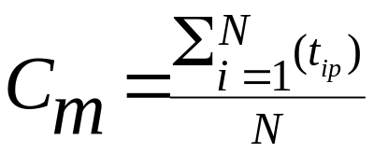


Centroid, Radius and Diameter of a Cluster (for numerical data sets)
Centroid: the “middle” of a cluster
Radius: square root of average distance from any point of the cluster to its centroid
Diameter: square root of average mean squared distance between all pairs of points in the cluster

Slide 10
Distance between Clusters
X
X
Centroid: distance between the centroids of two clusters
  dist(K_{i}, K_{j}) = dist(C_{i}, C_{j})
Medoid: distance between the medoids of two clusters
  dist(K_{i}, K_{j}) = dist(M_{i}, M_{j})
Average: average distance between an element in one cluster and an element in the other
  dist(K_{i}, K_{j}) = avg(t_{ip}, t_{jq})
Single link: smallest distance between an element in one cluster and an element in the other
  dist(K_{i}, K_{j}) = min(t_{ip}, t_{jq})
Complete link: largest distance between an element in one cluster and an element in the other
  dist(K_{i}, K_{j}) = max(t_{ip}, t_{jq})

Slide 11
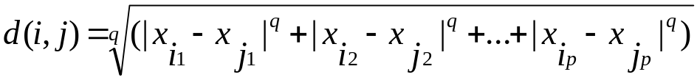


Similarity and Dissimilarity Between Objects
Distances are normally used to measure the similarity or dissimilarity between two data objects
Some popular ones include: Minkowski distance:
  where i = (x_{i1}, x_{i2}, …, x_{ip}) and j = (x_{j1}, x_{j2}, …, x_{jp}) are two p-dimensional data objects, and q is a positive integer
If q = 1, d is Manhattan distance:
If q = 2, d is Euclidean distance:
Also, one can use weighted distance, parametric pearson product moment correlation, or other disimilarity measures
Properties
  d(i, j) ≥ 0
  d(i, i) = 0
  d(i,j) = d(j,i)
  d(i,j) ≤ d(i,k) + d(k,j)

Slide 12
Considerations for Cluster Analysis
Partitioning criteria
  Single level vs. hierarchical partitioning (often, multi-level hierarchical partitioning is desirable)
Separation of clusters
  Exclusive (e.g., one customer belongs to only one region) vs. non-exclusive (e.g., one document may belong to more than one class)
Similarity measure
  Distance-based (e.g., Euclidian, road network, vector) vs. connectivity-based (e.g., density or contiguity)
Clustering space
  Full space (often when low dimensional) vs. subspaces (often in high-dimensional clustering)

Slide 13
Requirements and Challenges
Scalability
  Clustering all the data instead of only on samples
Ability to deal with different types of attributes
  Numerical, binary, categorical, ordinal, linked, and mixture of these
Constraint-based clustering
    User may give inputs on constraints
    Use domain knowledge to determine input parameters
Interpretability and usability
Others
  Discovery of clusters with arbitrary shape
  Ability to deal with noisy data
  Incremental clustering and insensitivity to input order
  High dimensionality

Slide 14
Type of Data in Clustering Analysis
Interval-scaled variables
Binary variables
Nominal, ordinal, and ratio variables
Variables of mixed types

Slide 15


Interval-scaled variables
Standardize data, given n measurements for variable f :
  Calculate the mean absolute deviation:
  where
  Calculate the standardized measurement (z-score):
Using mean absolute deviation is more robust to outliers than using standard deviation
Notes:
E.g., f is height, x1f and x2f are two measurements of f (x1f=1.2, x2f=1.5)

Slide 16
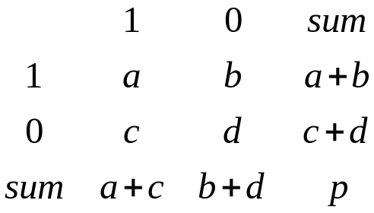
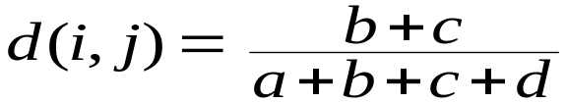
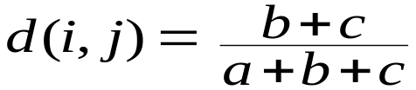
Binary Variables
A contingency table for binary data
Simple matching coefficient:
  invariant, if the binary variable is symmetric
Jaccard coefficient:
  noninvariant if the binary variable is asymmetric)
Object j
Object i
Notes:
Binary variable: 0 non smoker, 1 smoker
a is the number of variables that equal to 1 for both objects i and j
Symmetric: outcomes are equally important, e.g., male or female
Assymetric: outcomes are not equally important, e.g., positive or negative test result (usually positive is more significant)

Slide 17
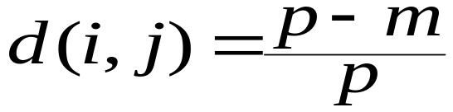
Nominal (Categorical) Variables
A generalization of the binary variable in that it can take more than 2 states:
  Ex: red, yellow, blue, green
Method 1: Simple matching
  m: # of matches, p: total # of variables
Method 2: use a large number of binary variables
  creating a new binary variable for each of the M nominal states
  Ex: a contingency table for each of red, yellow, blue, green

Slide 18


Ordinal Variables
Resembles a categorical variable, but order of the variable states is important
  e.g., rank
Can be treated like interval-scaled (continuous variables)
  replace x_{if} by their rank
  map the range of each ordinal variable onto [0, 1] by replacing
  r_{if} of the i-th object in the f-th variable by
  compute the similarity using methods for interval-scaled variables
Notes:
Useful for subjective assessments of qualities that can not be measured objectively

Slide 19
Major Clustering Approaches
Partitioning approach:
  Construct various partitions and then evaluate them by some criterion, e.g., minimizing the sum of square errors
  Typical methods: k-means, k-medoids, CLARANS
Density-based approach:
  Based on connectivity and density functions (DBSACN, OPTICS, DenClue)
Hierarchical approach:
  Create a hierarchical decomposition of the set of data (or objects) using some criterion (Diana, Agnes, BIRCH, CAMELEON)
Grid-based approach:
  based on a multiple-level granularity structure (ex: STING, WaveCluster)
Model-based:
  A model is hypothesized for each of the clusters and tries to find the best fit of that model to each other (ex: EM, SOM, COBWEB)

Slide 20

Partitioning Algorithms: Basic Concept
Partitioning a database D of n objects into a set of k clusters, such that the sum of squared distances is minimized (where c_{i} is the centroid or medoid of cluster C_{i})
Given k, find a partition of k clusters that optimizes the chosen partitioning criterion
  Global optimal: exhaustively enumerate all partitions
  Heuristic methods: k-means and k-medoids algorithms
  k-means : Each cluster is represented by the center of the cluster
  (MacQueen’67, Lloyd’57/’82):
  k-medoids (or PAM: Partition Around Medoids): Each cluster is represented by one of the objects in the cluster (Kaufman & Rousseeuw’87)

Slide 21
The K-Means Clustering Method
Given k, the k-means algorithm is implemented in four steps:
  1. Arbitrarily partition objects into k nonempty subsets
    Arbitrarily choose k objects as initial clusters’ centers
  2. Compute seed points as the centroids of the clusters of the current partition
    the centroid is the center (i.e., mean point) of the cluster
  3. Assign each object to the cluster with the nearest seed point
  4. Go back to Step 2, stop when no more new assignment

Slide 22



The K-Means Clustering Method Example
K=2
10
10
9
9
8
Update the cluster centroids
8
7
Assign each objects to most similar center
7
6
6
5
5
4
4
3
3
2
2
1
1
0
0
1
2
3
4
5
6
7
8
9
10
0
0
1
2
3
4
5
6
7
8
9
10
Arbitrarily partition objects into k groups (Arbitrarily choose K object as initial cluster center)
reassign
reassign
Steps:
- Partition objects into k nonempty subsets
- Repeat until no change
- Compute centroid (mean point) for each partition
- Assign each object to the cluster of its nearest centroid
Update the cluster centroids

Slide 23
Comments on the K-Means Method
Strength: relatively efficient comparing other algorithms
  O (k * n * t), where k is # clusters, n is # objects, and t is # iterations. Normally, k, t << n
Comment: Often terminates at a local optimum
  The global optimum may be found using techniques such as deterministic annealing and genetic algorithms
Weakness
  Applicable only when mean is defined
    Only to objects in a continuous n-dimensional space
    Using the k-modes method for categorical data
  Need to specify k in advance
    There are ways to automatically determine the best k (see Hastie et al., 2009)
  Sensitive to noisy data and outliers
  Not suitable to discover clusters with non-convex shapes

Slide 24
Variations of the K-Means Method
Handling categorical data: k-modes (Huang’98)
  Replacing means of clusters with modes for categorical data
  Using new dissimilarity measures to deal with categorical objects
  Using a frequency-based method to update modes of clusters

Slide 25
What is the problem of k-Means Method?
The k-means algorithm is sensitive to outliers !
  Since an object with an extremely large value may substantially distort the distribution of the data
K-Medoids: Instead of taking the mean value of the object in a cluster as a reference point, medoid (the most centrally located object in a cluster) can be used.
10
10
9
9
8
8
7
7
6
6
5
5
4
4
3
3
2
2
1
1
0
0
1
2
3
4
5
6
7
8
9
10
0
0
1
2
3
4
5
6
7
8
9
10

Slide 26
The K-Medoids Clustering Method
PAM (Partitioning Around Medoids, 1987)
  Find representative objects (medoids) in clusters
    Starts from an initial set of medoids
    Iteratively replaces one of the medoids by one of the non-medoids if it improves the total distance of the resulting clustering
  PAM works effectively for small data sets, but does not scale well for large data sets
Efficiency improvement on PAM
  CLARA (Kaufmann & Rousseeuw, 1990)
  CLARANS (Ng & Han, 1994): Randomized sampling
  Focusing + spatial data structure (Ester et al., 1995)

Slide 27

A Typical k-medoids Algorithm
K=2
Total Cost = 20
10
9
8
Arbitrary choose k objects as initial medoids
Assign each remaining object to nearest medoids
7
6
5
4
3
2
1
0
0
1
2
3
4
5
6
7
8
9
10
Randomly select a nonmedoid object,O_{ramdom}
Do loop
Until no change
Total Cost = 26
10
Compute total cost of swapping
10
Swapping Oj and O_{ramdom}
If quality is improved.
9
9
8
8
7
7
6
6
    o_{j}
5
5
4
4
3
3
o_{ran}
2
2
1
1
0
0
1
2
3
4
5
6
7
8
9
10
0
0
1
2
3
4
5
6
7
8
9
10

Slide 28
PAM (Partitioning Around Medoids)
PAM (Kaufman and Rousseeuw, 1987)
Use real object to represent the cluster
  1. Select k representative objects arbitrarily
  2. For each pair of (selected object o_{j} and non-selected object o_{ran} ), calculate the total swapping cost TC _{Oj Oran}
  3. For each pair of o_{j} and o_{ran},
    If TC _{Oj Oran} < 0, o_{j} is replaced by o_{ran}
    Then assign each non-selected object to the most similar representative object
  4. repeat steps 2-3 until there is no change
Total swapping cost
TC _{Oj Oran} =∑_{p} C _{p Oj Oran}

Slide 29
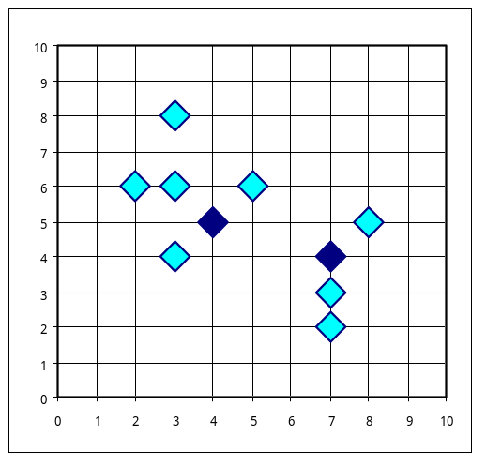
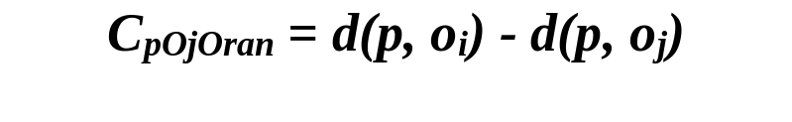
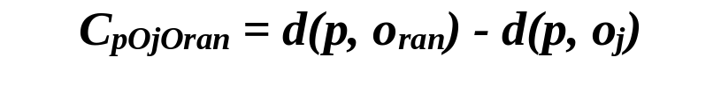
PAM Four Swapping Cases
TC _{Oj Oran} =∑_{p} C _{p Oj Oran}
When a medoid oj is to be swapped with a non-medoid object oran, check each of other non-medoid objects p
  p is in cluster of o_{j} ⇒ reassign p
    Case 1: p is closer to some o_{i} than to o_{ran} ;
    after swapping o_{j} and o_{ran} , p relocates to cluster represented by o_{i}
    Case 2: p is closer to o_{ran} than to o_{i} ;
    after swapping o_{j} and o_{ran} , p is in cluster represented by o_{ran}
Case 1
o_{ran}
Case 2
    o_{i}
p
p
o_{j}
    o_{i}
    o_{j}
o_{ran}
>= 0
Pos or neg

Slide 30
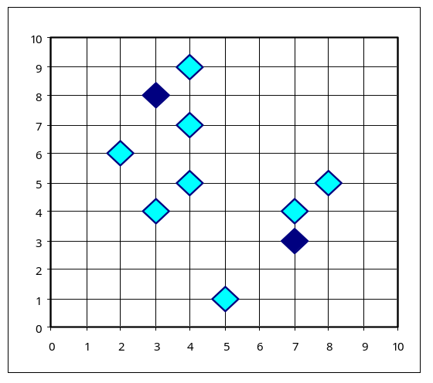
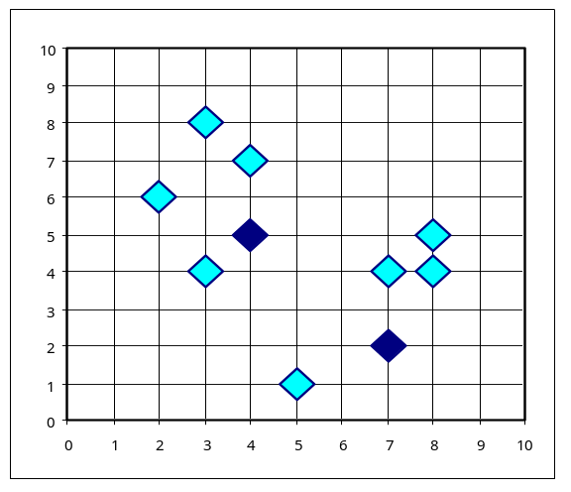

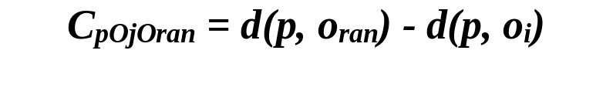
PAM Four Swapping Cases
TC _{Oj Oran} =∑_{p} C _{p Oj Oran}
When a medoid oj is to be swapped with a non-medoid object oran, check each of other non-medoid objects p
  p is in cluster of some o_{i} , not o_{j} ⇒ compare o_{i} with o_{ran}
    Case 3: p is closer to some o_{i} than to o_{ran} ;
    after swapping o_{j} and o_{ran}, p remains in cluster represented by o_{i}
    Case 4: p is closer to o_{ran} than to o_{i} ;
    after swapping o_{j} and o_{ran} , p is in cluster represented by o_{ran}
Case 3
p
Case 4
o_{i}
O(ran)이
더가까우니까
o_{j}
o_{ran}
o_{ran}
p
o_{j}
o_{i}
= 0
< 0

Slide 31
What is the problem with PAM?
PAM is more robust than k-means in the presence of noise and outliers because a medoid is less influenced by outliers or other extreme values than a mean
Time complexity is O(k(n-k)²)
  Work for small data sets (100 objects in 5 clusters)
  Not efficient for medium and large data sets

